Slide 1
An APC activator (IMP321 or LAG-3Ig) combined with anti-PD-1 blockade
Frédéric Triebel, M.D., PhD. , Prima Biomed Ltd

Slide 2
Three groups of patients responding to anti-PD-1 (IFN-γ signature)
A- Inflamed responders – respond to anti-PD-1
B- Inflamed non-responders (some infiltrates in the tumor margins but no response)
C- Non inflamed. “Cold tumor” with no response
Optimal checkpoint combos will target groups B and C and help them:
Promote cross presentation of tumor antigens
Induce T cell recruitment into tumor microenvironment

Slide 3
IMP321 induces a better Tc1 differentiation than sCD40L or TLR agonists
Human blood lymphocytes are analyzed in a 16 hr ex vivo assay
Intracellular staining of CD8 T cells
Only IMP321 induces IFN⁺ CD8 T cell responses
TLR agonists but not IMP321 induce IL-10 production which suppresses Tc1 differentiation

Slide 4
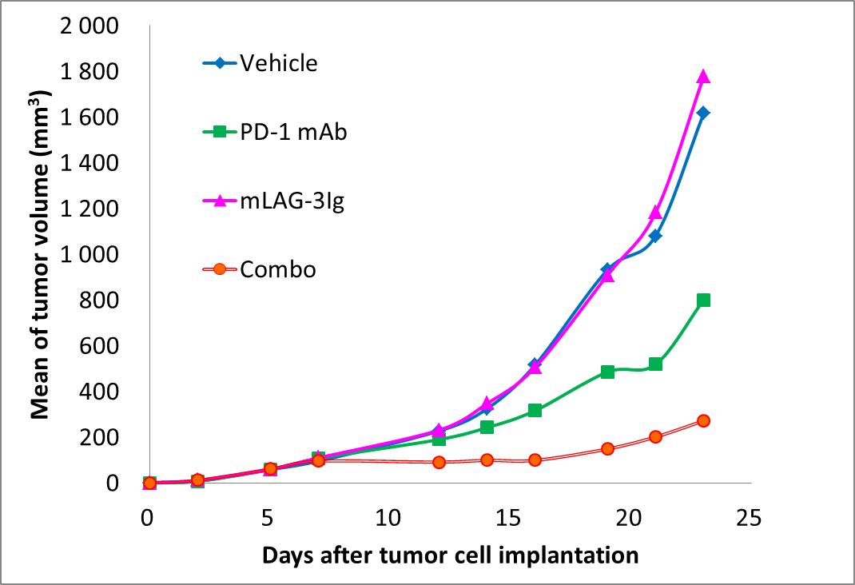
In vitro and in vivo preclinical data supporting the combination
CMV-stimulated PBMCs from 10 healthy donors
after 48hrs
Anti-PD-1 (10 mg/kg) + mLAG-3Ig (1 mg/kg)
In a subcutaneous CT26wt colon cancer model
IMP321 (ng/ml)
Anti-PD-1 (ng/ml)

Slide 5
TACTI-mel: Two ACTive Immunotherapeutics in melanoma
Phase I study in immuno-immuno combination in unresectable or metastatic melanoma in Australia
up to 24 patients,
3 cohorts,
max. 8 patients each
Multicenter, open label,
dose escalation
Safety
and
tolerability
IMP321 + anti-PD-1 (Keytruda®)
First patient in May 2016
Design Phase I, multi-centre, open-label, dose escalation
Primary Objective | Safety, tolerability and recommended dose finding for phase II with pembrolizumab + IMP321 in unresectable or metastic melanoma
Other Objectives | Pharmakokinetic and pharmakodynamic of IMP321, objective response rate, time to next treatment, progress-free survival
Patient Population | Patients with asymptomatic or suboptimal response after three cycles of pembrolizumab
Treatment | Up to 24 patients 3 cohorts: 1/6/30 mg IMP321; s.c. q2w + pembrolizumab; starting with the 5th cycle of pembrolizumab
Status report
6 clinical sites are approved and all are activated
Dose escalation decision of the interim data of the first cohort is expected at the end of this year
21
24

